Slide 1

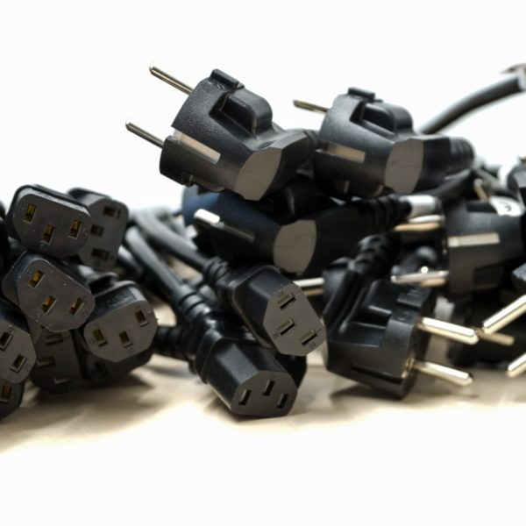
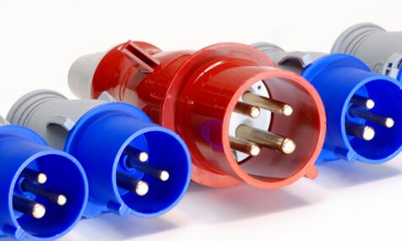

dba CHING CHENG WIRE MATERIAL CO., LTD.

Slide 2

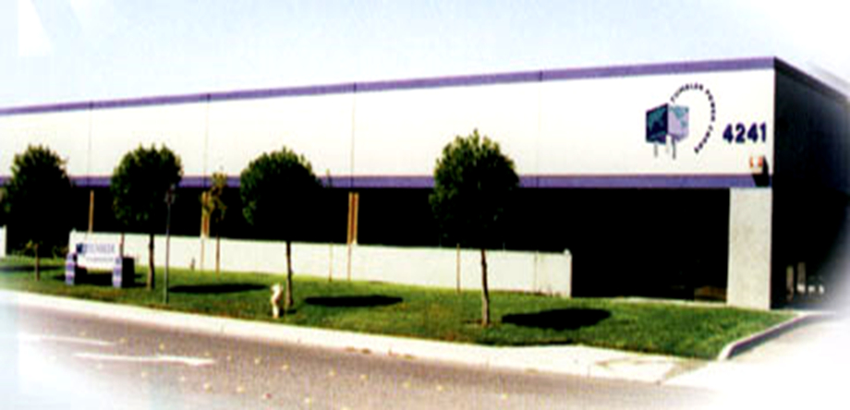
4241 Business Center Drive
Fremont, Ca 94538
Company History
Quality Policy – Safety Certifications
Capabilities and Capacities
Our Network and Markets
Our Organization
Products
Ching Cheng Manufacturing
Worldwide Listings
Accomplishments and Roadmap

Slide 3
Company History
1980 Ching Cheng Power cord manufacturer was established in Taiwan.
1982 Safety approvals obtained from various international agencies to start global marketing
1988 Tumbler Corp. was established in Fremont, California as the US Sales and Distribution main office.
1991 A high volume manufacturing factory was established in Guangdong, China.
1992 Two vertically integrated factories established to produce power cords from copper rod, PVC media, etc.
1995 Thailand factory was established, mainly, for wire harness and VAR operations.
2001 Expanded facilities in China to increase production capacity, reduce cost, and improve quality.
2002 All manufacturing facilities became ISO 9001:2000 certified.
2005 Implemented ISO 14001 to support environmental protection.
2005 Women Business Enterprise (WBE) Certified
2006 ISO 14001 :2004 Version Certificate to support environmental protection
2007 Linvox Corporation established to expand new products
2008 Our products have passed REACH.
2009 ChangAn factory had set up.
2010 Obtained the approval of Saudi Arabia
2011 Obtained CII Certificate from India
2012 Updated PSE approvals for Cord Sets
2013 Obtained Indonesian Safety Approvals
2019 2nd Thailand Factory being built to improve capabilities

Slide 4
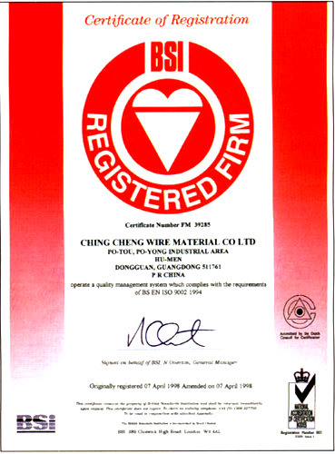
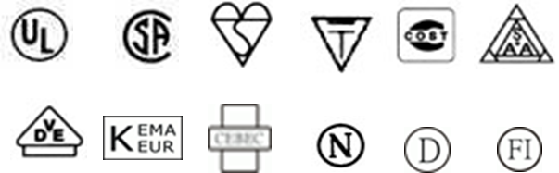
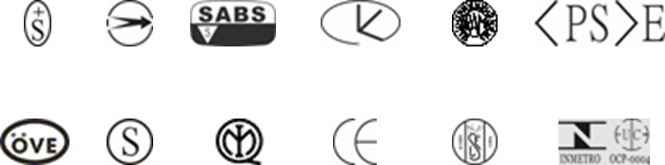
Quality Policy
Zero defect is our responsibility.
ISO 9001:2000 Certified by BSI Quality Management System.
Power Cords Approved by International Safety Listing Agents.

Slide 5
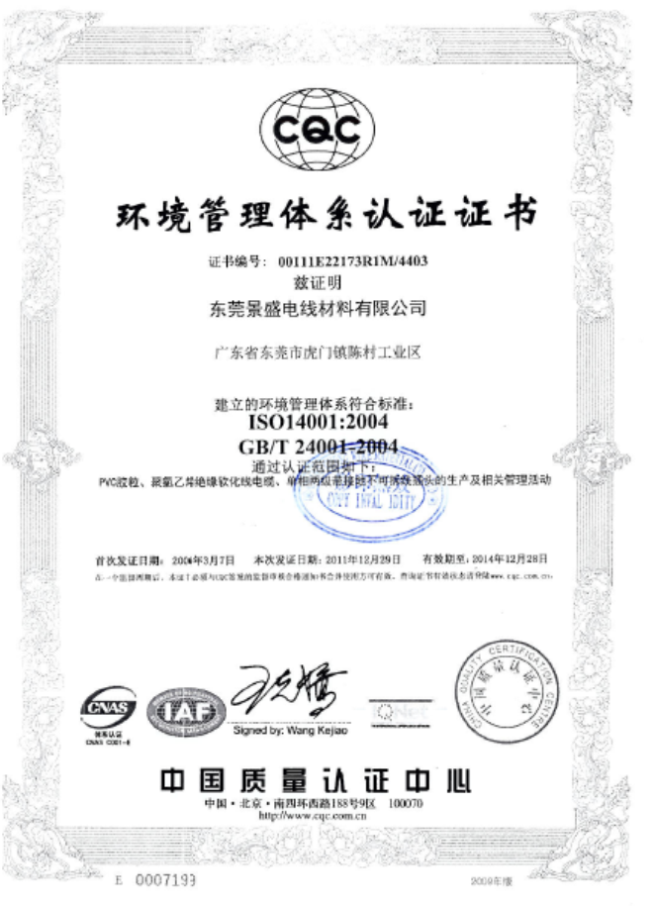
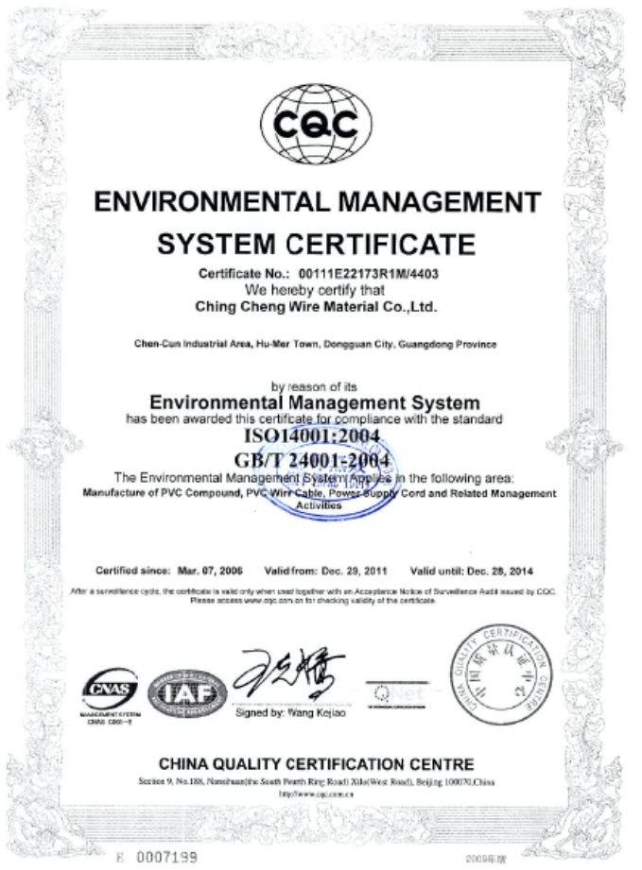
ISO 9001: 2015
ISO-14001:2004

Slide 6
Safety Listings and Certificates
Safety agency approvals from 39 countries, 5 continents.
Full library of safety regulations from UL, CSA, VDE, BSI, CCC, and PSE.
EMI/RFI compliant and CE certified for products required by the FCC and EEC.
Manufacturing facilities are certified by US, European and Asian agencies.
Continuous updates of country requirement changes and certificate maintenance.
Linvox will aid customers in obtaining certification for their custom power cords.

Slide 7
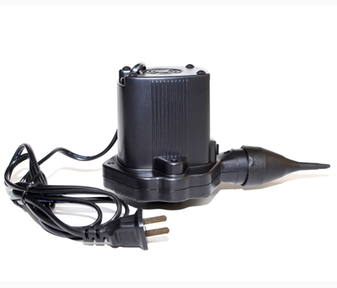
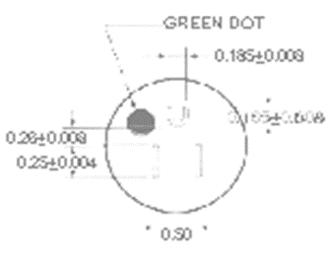
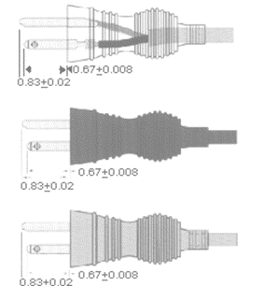
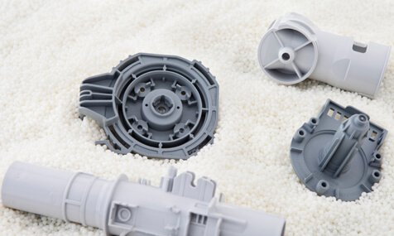
Capabilities, Capacity and Comprehensiveness
Vertically Integrated Manufacturing from Bunch Stranding , Extrusion to Molding.
Tool Design and Fabrication
5 Million Cord Sets/Month….$60 Million per Year Capacity
QA/QC/Quality Management Team Staffing : 66
Design/ME/Process Engineering Staffing: 21
Complete Product Safety Listing
ISO 14001: 2004 Version Certified
Patents in Plug and Connector Technology Fields
Value added capabilities including plastic injection molding and casting.

Slide 8
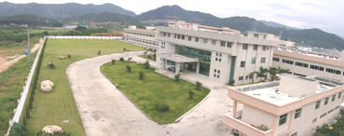
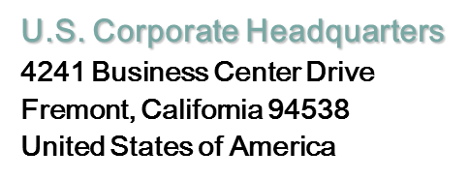
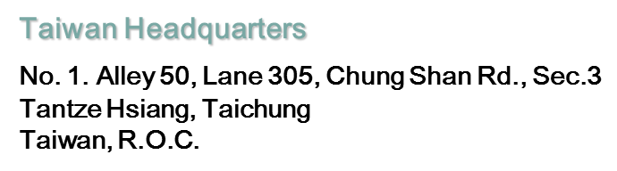
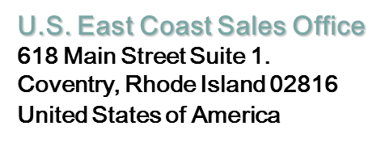

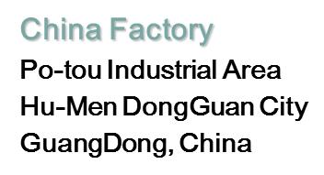
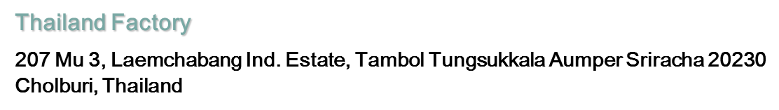
Global Network

Slide 9

Market Served
Consumer Electronics
Appliance
TV
Digital Converters/Receivers
VCR/DVD
Audio Systems
Fax Machines
Other - Fans, Heaters, etc.
Equipment
Telecommunications
Automotive
Medical
Electronics
ATM
Switches
Networking
P.C. Peripherals
Servers
Hubs
Routers
Personal Computer
Printers/Plotters
Scanners
UPS
Power Supplies
Monitors
PC Main Power Supply

Slide 10
Organization Chart
General Manager
General Manager
Secretary
Secretary
Assistant General Manager
Direction of Factory
Import & Export Customs
Assistant General Manager
Direction of Factory
Import & Export Customs
Secretary
Secretary
Production Dept
Engineering Dept
QA Dept
Business Dept
Operation Dept
Production Dept
Engineering Dept
QA Dept
Business Dept
Operation Dept
Secretary
Secretary
Secretary
Secretary
Quality Assurance Section
R&D Section
Document Control Center
A Region Manager
B Region Assistant Manager
Office Work: Domestic / Foreign Sales
Finance
HR
Customer Service
Procurement
Quality Assurance Section
R&D Section
Document Control Center
A Region Manager
B Region Assistant Manager
Office Work: Domestic / Foreign Sales
Finance
HR
Customer Service
Procurement
Plug Molding Plant
PVC Pellet Plant
Power Cord Plant
Logistics / Warehouse
Engineering Tech
Printing Dept
CAD Dept
Sample Control
Tooling Control
Production Management
Plug Molding Plant
PVC Pellet Plant
Power Cord Plant
Logistics / Warehouse
Engineering Tech
Printing Dept
CAD Dept
Sample Control
Tooling Control
Production Management

Slide 11
Employee Distribution

Slide 12
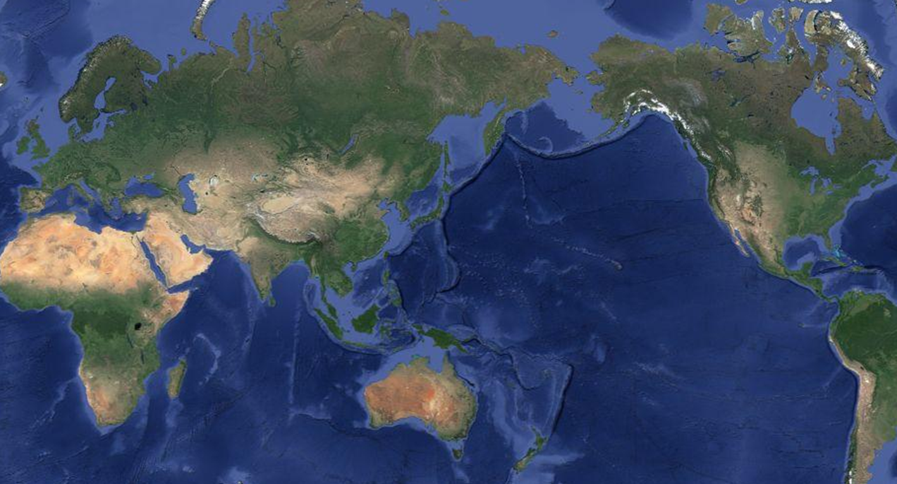



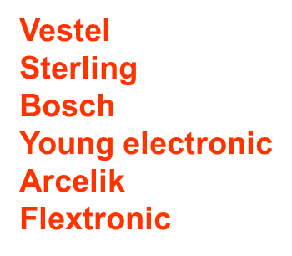
Customer Base
Robert Bosch Power Tools
Oracle
Cisco Systems
Celestica
Foxconn
Intel
Facebook
Nvidia
Network Appliance
Jabil
Xerox
Arrow Electronics
35%
20%
43%
2%
CARINDA

Slide 13

Total Quality Management
Company-wide commitment to continuous performance improvement, product quality, and meeting customer requirements.
All manufacturing facilities are ISO 9001:2000 certified.
Reducing development cycle times and product and service costs on new custom designed power cords.
Proactive Oriented - Problems must be prevented, not just fixed.
Emphasis in continuous improvement rather than maintenance.
Zero defect. Products are 100% tested. Defected item are eliminated immediately.
Doing it right the first time.
100% Customer satisfaction

Slide 14


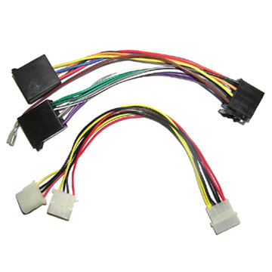
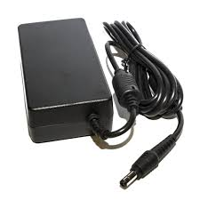
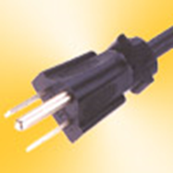
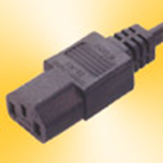
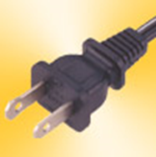
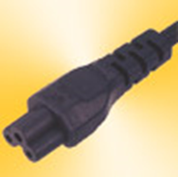
Products
Over 130 types of plug and connector designs and patents
Plug and connector types comply to worldwide specifications: NEMA, IEC, 2 or 3 conductors, polarized, locked, hospital and various industry usages.
North America (UL & CSA) cord types: 10~18 AWG, SPT, SVT, SJT and rubberized cordages in various permutations for oil, weather, water resistance, temperature and voltage.
International (BSI, CEBEC, VDE, etc) cord types: 1.5~0.75mm2, H03VV-F, H05VV-F, VCT, VFF, etc.
Customized power cords: Plugs, connectors, terminals, shielded, length, strain relief, stripped end, color of outer and inner jackets, high temperature, etc.
Customer design aid: Design drawings provided, safety approvals and fabricate tools in house to shorten the lead time and process.
Power Supply Unit Distributor (PSUs)
Wire Harnesses and Computer Cables

Slide 15
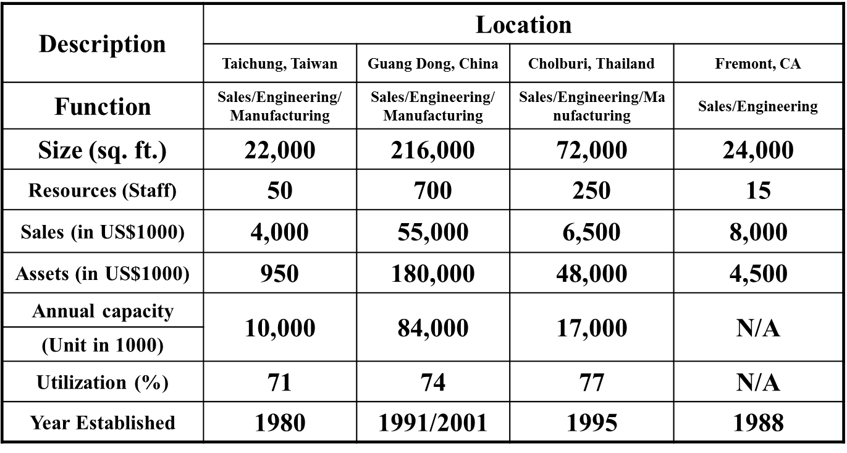
Facilities Fact Sheet 2017

Slide 16
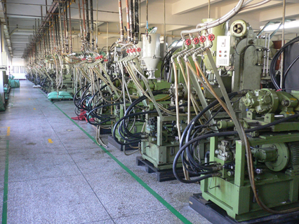
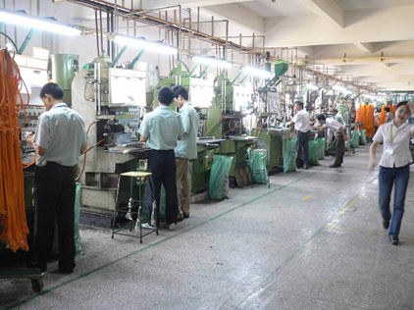
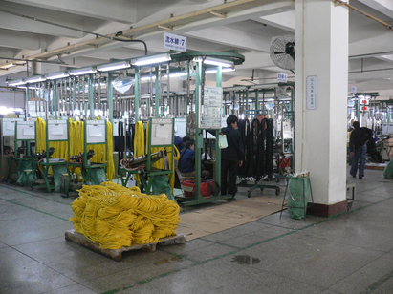
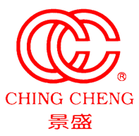
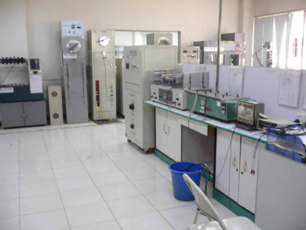
Manufacturing Facilities

Slide 17
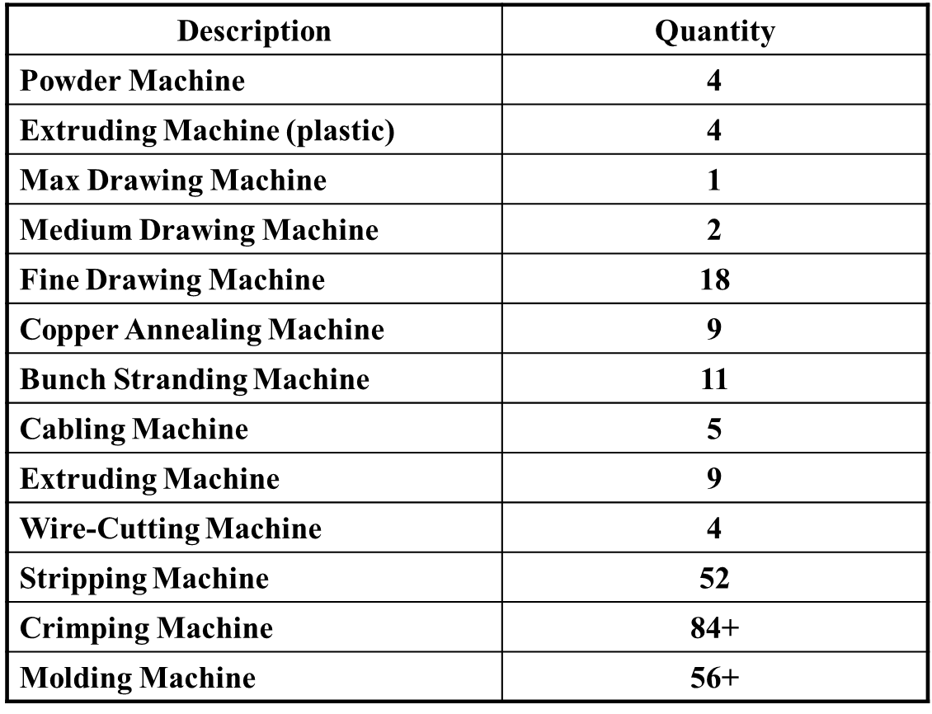
Major Equipment List

Slide 18
Accomplishment
60
55
51
52.2
50
48
50
43
45
41
40
40
38
35
30
20
10
Unit: Million USD
0
2007
2008
2009
2010
2011
2012
2013
2014
2015
2016
2017

Slide 19
Our Advantages
Power Cord Leader
Over 20 years of experience in the power cord industry. Created a satisfied customer base which includes Tier 1, Top 500 and major OEMs companies worldwide.
Extremely Price Competitive
Total vertical integrated manufacturer is capable of controlling the quality and cost from raw materials to the finished product.
On Time Delivery for Quality Products
Total Quality Management and International Logistics system to fit into your product quality and delivery requirements.
Technology leader
Able to support your custom design on specification, materials, lead-time, cost and safety agencies’ requirements.

Slide 20
Road Map
Maintain Leadership in Pricing, Quality, Service and Technology.
Research in engineering technology for advanced design demands.
Work with manufacturing representatives to support local customers.
Exposure to medical and various industrial power cord markets.
Worldwide Logistics support system to deliver quality product on time.
Expand direct coverage to Southern Asia from our Thailand factory.
Expand direct coverage to Western European Countries.
Global safety agency network updates safety requirements continuously.
Expansion projects - two new facilities in East & N.E. China (on hold).
Implement ISO 14001 and maintain lead free, RoHS requirements.
Expansion of customer accounts and development of various product lines.

